Slide 1
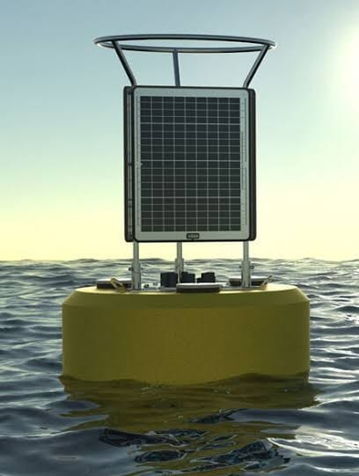
Solar Sea Buoy for Maritime Safety.

Slide 2
Agenda
1
2
3
4
5
Introduction & Problem Statement
System Working & Technologies Used
Components Used
Benefits & Impact
Conclusion & Future Scope

Slide 3
Introduction
The Solar Sea Buoy is an intelligent maritime monitoring system designed to enhance ocean safety and security. It tracks ships using RFID and barcode, ensuring that vessels return
within the specified time and alerting the control room if they don't. Additionally, it detects unauthorized submarines, marine predators, and monitors water conditions
using advanced sensors, transmitting real-time alerts via wireless communication.

Slide 4
Introduction & Problem Statement
Problem:
Ships entering grey areas may not return within time.
Unauthorized submarine entries pose national security risks.
Sea predators threaten small boats and fishermen.
Water quality (temperature, humidity, and pH) affects marine life and navigation.
Solution:
A solar-powered buoy using STM32F103C8T6 to process data from multiple sensors.
Alerts control rooms about missing ships, unauthorized submarines, and predator threats.
Monitors water temperature, humidity, and pH for environmental analysis.

Slide 5
System Working & Technologies Used
STM32F103C8T6 (Blue Pill) → Main microcontroller, processes all sensor data and transmits alerts.
RFID & Barcode Tracking → Monitors ship entry & exit from grey areas.
433 MHz Transmitter / LoRa / GSM → Sends alerts to the control room.
Sonar / Hydrophone → Detects foreign submarines.
Marine Predator Detection → Identifies dangerous sea creatures.
Solar Power System → Ensures continuous operation.
Temperature & Humidity Sensors → Helps in weather and oceanic condition analysis.
pH Sensors → Checks water pollution levels.

Slide 6
Components & Sensors Used
STM32F103C8T6 (Blue Pill) → Processes all data and controls communication.
RFID Reader & Tags → Ship tracking.
Barcode Scanner → Alternative tracking method.
Sonar/Hydrophone → Submarine detection.
Ultrasonic Sensor / IR Sensor → Detecting predator movement.
GPS Module → Location tracking of boats.
433 MHz Transmitter & Receiver → Communication with control room.
Temperature & Humidity Sensor (DHT22/DS18B20) → Monitors water temperature and air humidity.
pH Sensor → Detects water pollution levels.
Solar Panel & Battery → Power source.

Slide 7
Benefits & Impact
Maritime Security → Early warning for unauthorized submarines.
Fishermen Safety → Alerts for predator threats.
Ship Monitoring → Ensures timely returns from grey areas.
Eco-friendly → Solar-powered and sustainable.
Environmental Monitoring → Detects temperature, humidity, and pH changes affecting marine life.
Disaster Prevention → Can help predict storms or environmental hazards.
Efficient Processing → STM32F103C8T6 ensures fast and reliable sensor data handling.

Slide 8
Conclusion & Future Scope
Conclusion:
The Solar Sea Buoy enhances maritime security, safety, and environmental monitoring.
Helps prevent missing ships and unauthorized submarine entries.
Protects small boats from marine predators.
Monitors temperature, humidity, and pH for better ocean research.
Powered by STM32F103C8T6, ensuring low power and high efficiency.
Future Scope:
AI-based pattern recognition for better threat detection.
Satellite communication for remote monitoring.
Integration with weather forecasting systems for storm alerts.

Slide 9
Summary
&.STM32F103C8T6 is the brain of the system, handling all sensors and data processing.
&. 433 MHz TX / RX & LoRa/GSM are used to send alerts & receive commands from the control room.
&. Multiple sensors (RFID, barcode, sonar, GPS, pH, temperature, etc.) ensure full maritime monitoring.
&.Solar-powered design for continuous operation at sea.

Slide 10
THANK YOU…

